Slide 1
Large Language Model SECURITY
SPRING-2024: (DAEN-690) Data Analytics Capstone Project
Team: Safe House Instructor: Dr. Reyna Rollins
Class Date : May 3rd, 2024 Partner: Dr. Curt Rasmussen
Notes:
https://elcosh.org/document/1648/d000560/preventing-muskuloskeletal-disorders-in-construction-workers.html
https://www.predi
https://injuryfacts.nsc.org/work/costs/work-injury-costs/ctivesafety.com/blog/10-tips-to-manage-workplace-fatigue

Slide 2






team Members
Suyog Suresh Patagave Scrum Master
Rahul Kumar Shivakumar Product Owner
Bharath Sundar Rajan Developer & Quality Manager
Kanganut Jiradejdamrong Developer
Matin Jahani Developer
Unnathi Nandula Developer

Slide 3
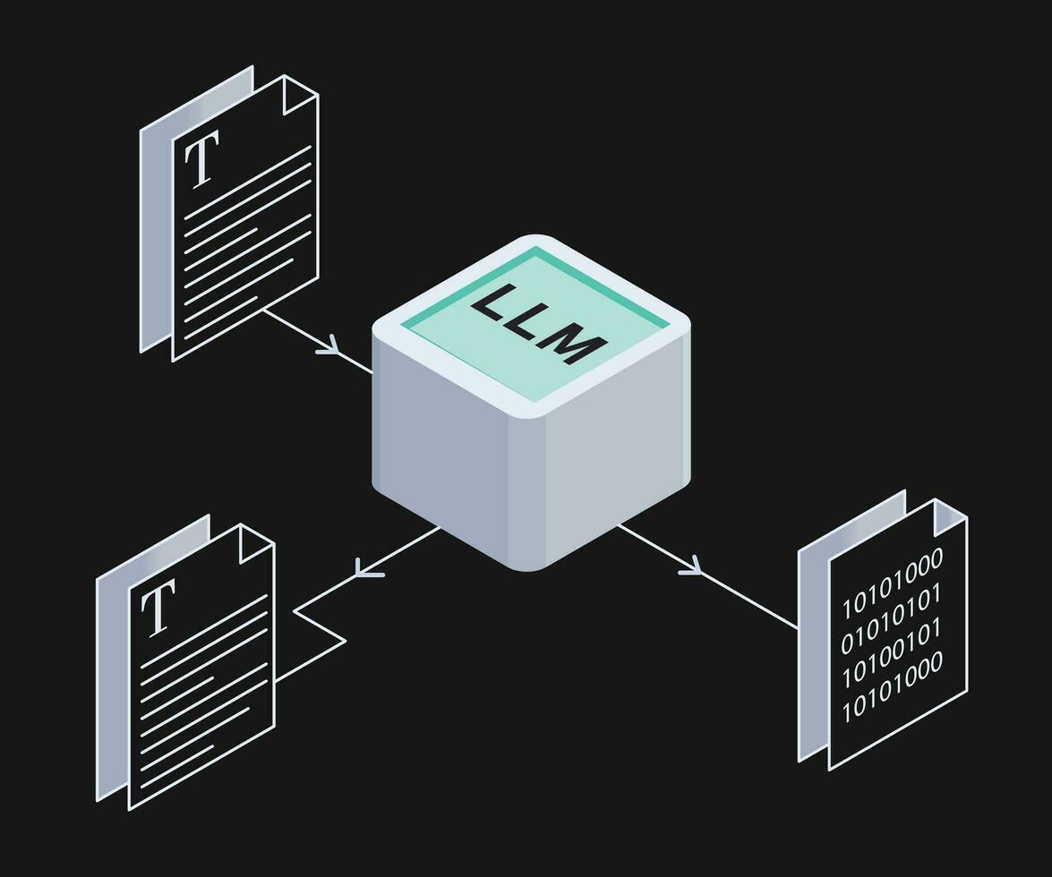
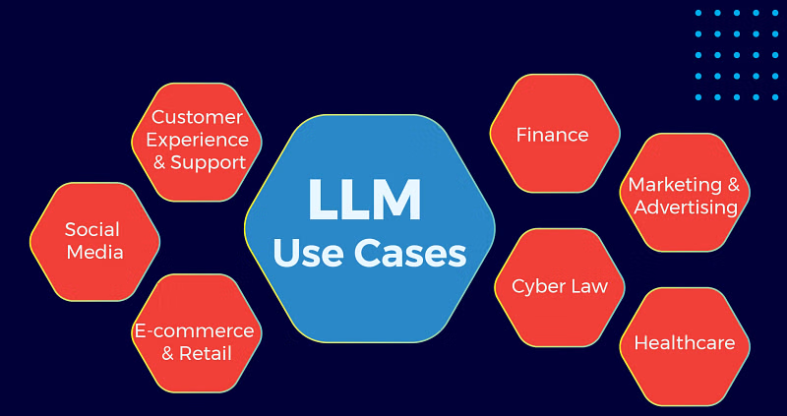
Introduction
What are Large Language Models?
Large Language Models (LLMs) are very large deep learning models that are pre-trained on vast amounts of data.
LLMs perform tasks such as answering questions, summarizing documents, translating languages, and completing sentences.
Top Vulnerabilities of LLMs
Prompt Injection | Influencing the output of the LLMs by providing specific instructions within the input text.
Insecure Output Handling | Inadequate protection of sensitive information.
Training Data Poisoning | Manipulating the data used to train LLMs.

Slide 4
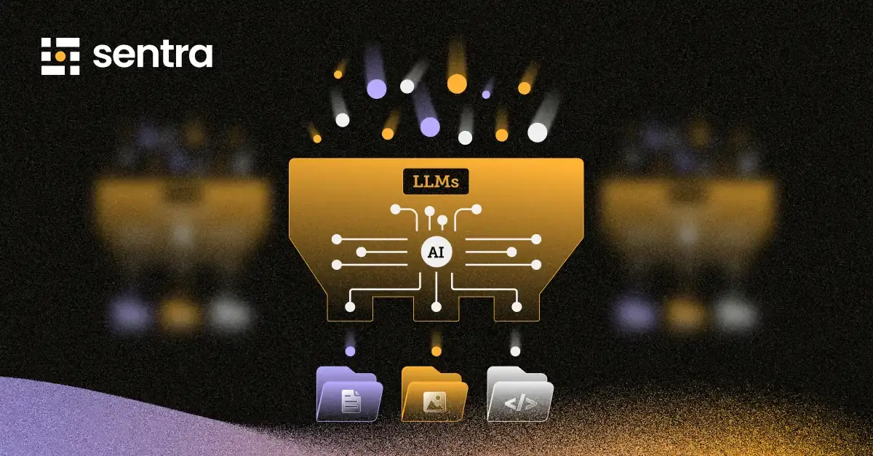



problem SPACE
Aim and Objective of the Research
There is a significant lack of guidance to inform industries about LLM vulnerabilities.
Our goal is to devise a risk model and framework to inform about the risk of LLM use across industries.

Slide 5



Project Phases
EXPLORATION
VULNERABILITIES
ASSESSMENT
Web scrapping and AI/ML techniques to find information from various sources.
Potential impact and difficulty of LLM attacks
Develop a list of industries and/or activities to compare LLM vulnerabilities.
Develop a method for assessing and comparing LLM attack risk between industries and/or activities.

Slide 6
Recap OF THE PROJECT
i
Literature Review
Research on LLM applications in various fields and LLM based attacks.
ii
Data Resources
Referred to VERIS, MITRE ATLAS, and CENSUS datasets.
Web-scraped articles related to LLMs.
iii
Exploratory Analysis
Started to explore datasets and analysis. Gathered information on risk analysis.
iv
Risk Analysis
Mapping LLM attack techniques.
Forming Lorenz’s curve (Risk Model 1) and a custom framework to calculate risk metrics (Risk Model 2).
v
Results
Visualization dashboard showcasing risk across industries.

Slide 7
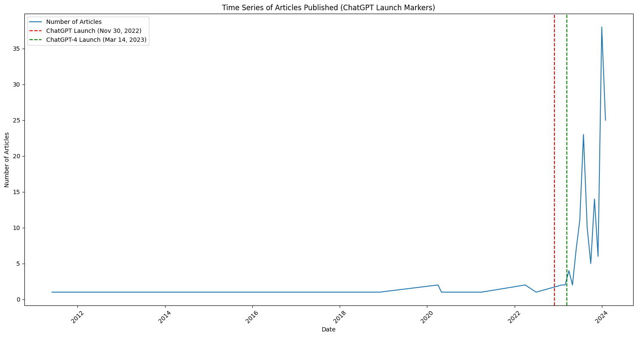
Exploratory data analysis
Data was Scraped using Google News RSS and Bing News API (News articles related to LLM attacks). The graph shows spikes in LLM articles after March 2023, when Chat GPT 4 was launched.

Slide 8
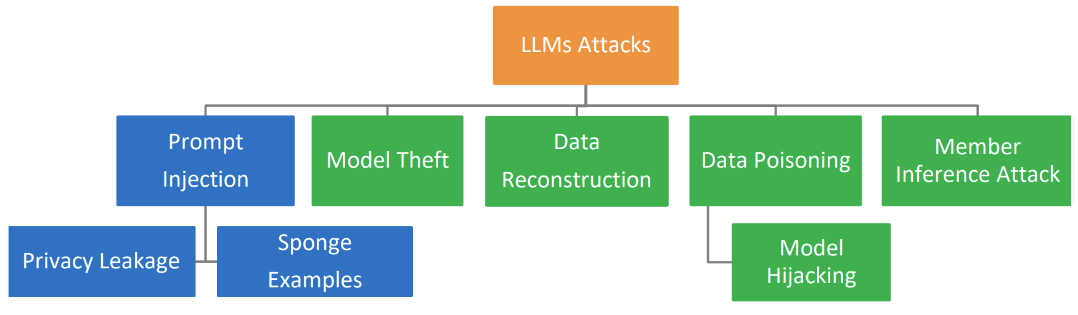
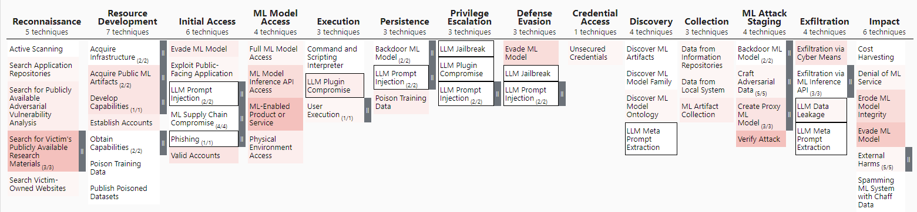
Compilation of LLM Related ADVERSARIAL BEHAVIOUR
MITRE Adversarial Threat Landscape for Artificial-Intelligence Systems (ATLAS)
An open-source community-driven knowledge base that documents adversary behavior based on real-world observations of security incidents.
LLM-based Attack Techniques (by MITRE Corp):
LLM Data Leakage
LLM Jail Break
LLM Meta Prompt Extraction
LLM Plugin Compromise
LLM Prompt Injection (Direct & Indirect)
Phishing (Spear-phishing via LLM Social Engineering)

Slide 9
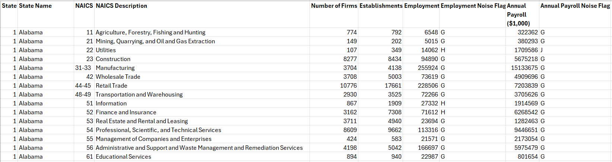
CENSUS DATASET
• Census Dataset contains statics of U.S. Businesses, classified by North American Industry Classification System (NAICS) codes.
• Total number of firms in each industrial sector (NAICS codes) by state will be aggregated with risk scores to perform risk assessment.
*Public Sector is not included in CENSUS dataset (NAICS code 92)

Slide 10
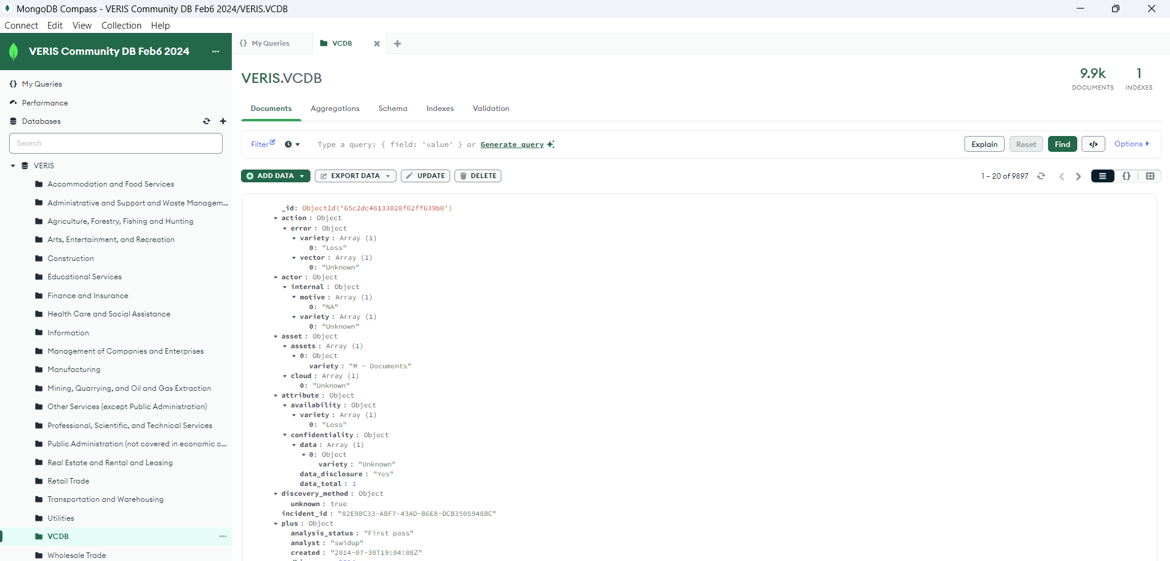
VERIS community DATAbase
Vocabulary for Event Recording and Incident Sharing (VERIS) Community Database
Open-source data repository that was launched and is maintained by the Verizon RISK team.
The VERIS Schema includes variables for:
Incident Tracking, Victim demographics, Incident description(4As: Actors, Actions, Assets, Attributes), Impact Assessment.
An Example of an Incident Record from the VERIS dataset:
(JSON Format & Highly Nested)
{ "_id": { "$oid": "65c2dc46133020f62ff639b0" }, "action": { "error": { "variety": [ "Loss" ], "vector": [ "Unknown" ] } }, "actor": { "internal": { "motive": [ "NA" ], "variety": [ "Unknown" ] } }, "asset": { "assets": [ { "variety": "M - Documents" } ], "cloud": [ "Unknown" ] }, "attribute": { "availability": { "variety": [ "Loss" ] }, "confidentiality": { "data": [ { "variety": "Unknown" } ], "data_disclosure": "Yes", "data_total": 1 } }, "discovery_method": { "unknown": true }, "incident_id": "82E9BC33-ABF7-43AD-B6E8-DCB3505948BC", "plus": { "analysis_status": "First pass", "analyst": "swidup", "created": "2014-07-30T19:04:08Z", "dbir_year": 2014, "master_id": "82E9BC33-ABF7-43AD-B6E8-DCB3505948BC", "modified": "2015-02-13T16:50:36Z" }, "reference": "http://vcdb.org/pdf/va-security.pdf", "schema_version": "1.3.7", "security_incident": "Confirmed", "source_id": "vcdb", "summary": "A principal investigator reported to the Research Compliance officer that a research consent form containing an individual's full name and full social security number cannot be located.", "timeline": { "incident": { "day": 5, "month": 5, "year": 2010 } }, "victim": { "country": [ "US" ], "employee_count": "Over 100000", "government": [ "Unknown" ], "industry": "923140", "region": [ "019021" ], "state": "TX", "victim_id": "United States Department of Veterans Affairs" }}

Slide 11
SOLUTION ARCHITECTURE
LLM attack types
VERIS Database
Filter: Attacks
Country: US
Period: 2020- present
MITRE ATLAS (Adversarial Threat Landscape for Artificial-Intelligence Systems)
LLM Attack Techniques(Ind spec) via Literature Survey
Risk Model
CENSUS (SUSB: Statistics of US Businesses)
Risk Model – 2
Risk Framework
Mapping
Risk Model – 1
Gini Index and Lorenz Curve
NAICS (North America Industry Classification System) and CENSUS (SUSB: Statistics of US Businesses)
Data insights
Exploratory and Frequency Analysis
Construct a Risk Model

Slide 12





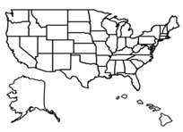
VERIS COMMUNITY DATABASE (VCDB) ANALYSIS WORKFLOW PARADIGM
Github.com/vz-risk/VCDB
Data Source
Submitted
Data Ingestion
Mining Insights
Validated
Overridden
10,262 incidents(as .json files)
*As of 23rd Jan 2024
Data Cleaning
Post Cleaning: 10085 incidents.
What kind of insights, should we look to uncover from the data?
Data insights
Frequency Analysis of Vulnerabilities across Industries
Construct a Risk Assessment Framework
Build a visualization dashboard showcasing risk across industries

Slide 13
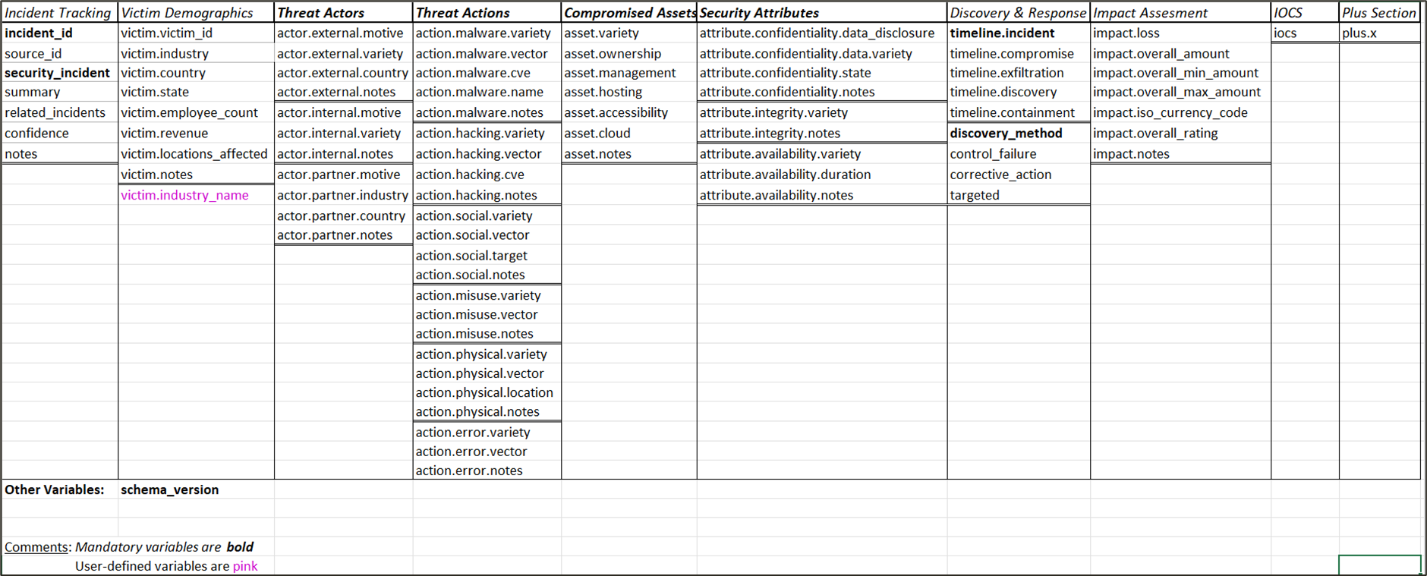
DEVELOPING A RISK MODEL BASED ON THE VERIS FRAMEWORK
1
2
3
4
5
Risk Model
Threats : The scope and nature of threats posed by malicious actors (adversaries) targeting an organization.
Actions : The range of potential attack techniques and their ease of exploitability against an organization.
Assets : Analysis of an organization's valuable assets.
Attributes: The potential compromise of their security attributes (confidentiality, integrity, and availability).
Impacts: The potential severity of disruption to an organization's operations in the event of a security incident.
Threat
Actions
1
2
RISK
5
3
Impact
Asset
4
Attribute

Slide 14
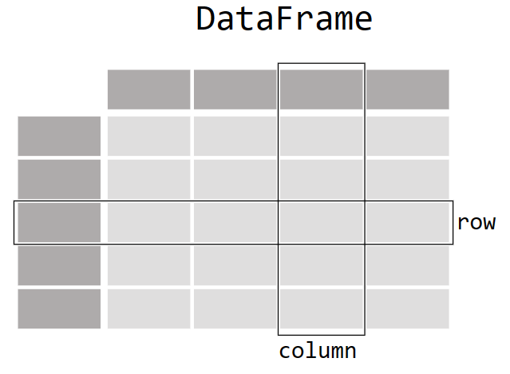


TECHNICAL CHALLENGE: NEED FOR A UNIVERSAL APPROACH TO CONDUCT FREQUENCY ANALYSIS
Python Function:
group_by_count_to_df(fields_tags, match_query , addFields , ordinal_sort)
CONNECT
Parsing&Sorting
Results
Data insights
Frequency Analysis of Vulnerabilities across Industries
Frequency Analysis
Results
Set of .json docs with nested fields.
EXPORT
VCDB Dataset
Set of .json docs with nested fields.
Build a visualization dashboard showcasing risk across industries
Visualization

Slide 15
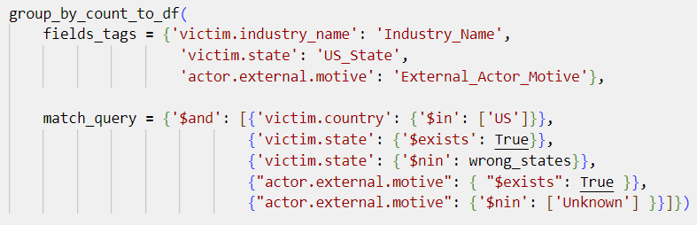
ILLUSTRATION OF THE POWER OF USING THE FREQUENCY AGGREGATION FUNCTION
Industry_Name | Count_Industry_Name | US_State | Count_US_State | External_Actor_Motive | Count_External_Actor_Motive
Educational Services | 740 | CA | 84 | ('Financial',) | 84
 |  | NY | 70 | ('Financial',) | 69
 |  |  |  | ('Ideology',) | 1
 |  | NC | 51 | ('Financial',) | 51
 |  | TX | 41 | ('Financial',) | 40
 |  |  |  | ('Grudge',) | 1
 |  | FL | 25 | ('Financial',) | 23
 |  | PA | 25 | ('Financial',) | 23
 |  | FL | 25 | ('Fun',) | 2
 |  | PA | 25 | ('Grudge',) | 1
 |  |  |  | ('Fun',) | 1
 |  | MO | 23 | ('Financial',) | 22
 |  |  |  | ('Ideology',) | 1
 |  | IL | 21 | ('Financial',) | 21
 |  | NJ | 20 | ('Financial',) | 20
 |  | VA | 20 | ('Financial',) | 19
 |  |  |  | ('Fun',) | 1
 |  | CT | 19 | ('Financial',) | 19
 |  | MA | 19 | ('Financial',) | 18
 |  |  |  | ('Grudge',) | 1
 |  | WA | 18 | ('Financial',) | 18
 |  | OK | 18 | ('Financial',) | 18
 |  | AZ | 17 | ('Financial',) | 17
 |  | MI | 17 | ('Financial',) | 16
 |  |  |  | ('Fun',) | 1
 |  | GA | 16 | ('Financial',) | 16
 |  | AL | 16 | ('Financial',) | 15
 |  |  |  | ('Fun',) | 1
 |  | WI | 15 | ('Financial',) | 15
 |  | IA | 15 | ('Financial',) | 14
 |  | OH | 15 | ('Financial',) | 14
 |  | IA | 15 | ('Fun',) | 1
 |  | OH | 15 | ('Ideology',) | 1
 |  | MN | 12 | ('Financial',) | 11
 |  |  |  | ('Ideology',) | 1
 |  | TN | 11 | ('Financial',) | 11
 |  | KS | 11 | ('Financial',) | 11
 |  | ID | 11 | ('Financial',) | 11
 |  | SC | 10 | ('Financial',) | 10
 |  | KY | 10 | ('Financial',) | 10
 |  | LA | 10 | ('Financial',) | 10
 |  | CO | 10 | ('Financial',) | 10
 |  | MD | 9 | ('Financial',) | 9
 |  | OR | 8 | ('Financial',) | 8
 |  | IN | 8 | ('Financial',) | 8
 |  | NE | 8 | ('Financial',) | 8
 |  | NM | 7 | ('Financial',) | 6
 |  |  |  | ('Other',) | 1
 |  | MS | 6 | ('Financial',) | 6
 |  | WV | 6 | ('Financial',) | 6
 |  | DC | 5 | ('Financial',) | 5
 |  | AK | 4 | ('Financial',) | 4
 |  | NV | 4 | ('Financial',) | 4
 |  | ME | 4 | ('Financial',) | 4
 |  | UT | 4 | ('Financial',) | 4
 |  | VT | 3 | ('Financial',) | 3
 |  | RI | 3 | ('Financial',) | 3
 |  | NH | 3 | ('Financial',) | 3
 |  | DE | 2 | ('Financial',) | 2
 |  | AR | 2 | ('Financial',) | 2
 |  | SD | 2 | ('Financial',) | 2
 |  | ND | 1 | ('Financial',) | 1
 |  | WY | 1 | ('Financial',) | 1
Build a visualization dashboard showcasing risk across industries

Slide 16








Essential LLM Attack Techniques and their respective Tactic Scopes
LLM Prompt Injection
LLM Meta Prompt Extraction
LLM Data Leakage
Extract LLM Model
Initial Access
Persistence
Defense Evasion
Privilege Escalation
Discovery
Exfiltration
Exfiltration
Exfiltration
Spearphishing via Social Engineering an LLM
LLM Plugin Compromise
LLM Cost Harvesting
LLM Jailbreak
Defense Evasion
Privilege Escalation
Initial Access
Execution
Privilege Escalation
Impact

Slide 17

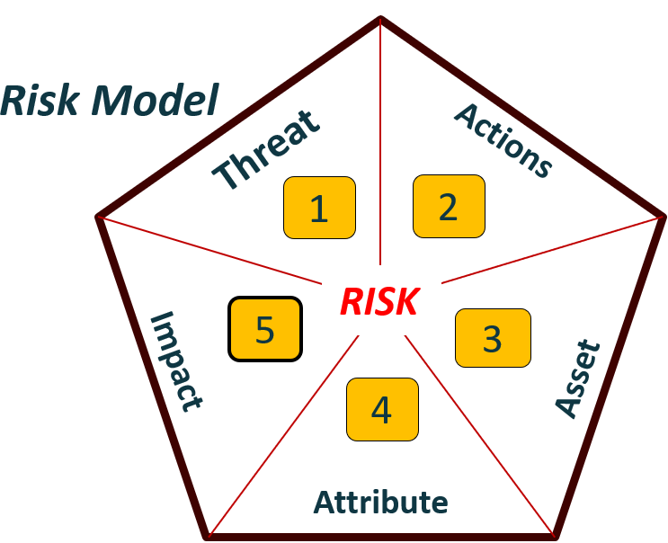
Key Considerations for Mapping MITRE ATLAS LLM to VERIS Cyberattack Techniques
MITRE ATLAS Artificial Intelligence Threat Landscape
VERIS Cybersecurity Landscape
Categories of VERIS Cyberattack techniques
MITRE ATLAS ID | LLM Attack Technique | MITRE ATLAS Tactic Scope
AML.T0051 | LLM Prompt Injection | Initial Access Persistence Defense Evasion Privilege Escalation
AML.T0056 | LLM Meta Prompt Extraction | Discovery Exfiltration
AML.T0057 | LLM Data Leakage | Exfiltration
AML.T0052.000 | Spearphishing via Social Engineering an LLM | Initial Access
AML.T0053 | LLM Plugin Compromise | Execution Privilege Escalation
AML.T0054 | LLM Jailbreak | Defense Evasion Privilege Escalation
AML.T0034 | Cost Harvesting | Impact
AML.T0024.002 | Extract LLM Model | Exfiltration
Malware
Hacking
Social
MAP
Misuse
Physical
Error
Environment

Slide 18
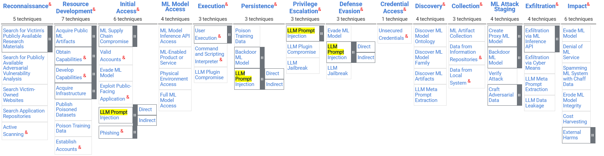
ILLUSTRATION OF THE MAPPING PROCESS
LLM Prompt Injection (AML.T0051)
Direct (AML.T0051.000)
Indirect (AML.T0051.001)
1. Understanding the techniques / sub techniques:
LLM Prompt Injection involves “adversaries crafting malicious prompts as inputs to an LLM that cause the LLM to act in unintended ways, where the adversary can directly inject the prompt from the user side, or the malicious prompts are ingested from a another (indirect) data source.”
2. Locating the techniques within the MITRE ATLAS Matrix, in order to understand the myriad of potential adversarial tactics (“goals of the adversary during an attack”) :

Slide 19
Illustration Of The Mapping process between MITRE ATLAS LLM Techniques and VERIS Cybersecurity Attack Techniques
LLM Prompt Injection (AML.T0051)
LLM Prompt Injection, Tactics and their Implications
Tactics:
Initial LLM model Access, followed by Persistence, Defense Evasion and Privilege Escalation by the adversary.
Implications:
Initial Access Vector into the LLM model
Persistent foothold within the victim system
Avoid and Bypass Defenses
Triggering Unauthorized Actions
maps to
Malware
Client-side attack
Backdoor
C2 (Command and Control)
Hacking
Abuse of functionality
User Breakout
Cross-site Scripting (XSS)
SQL Injection
HTTP request smuggling/splitting
Misuse
Knowledge Abuse
Privilege Abuse
Possession Abuse
Evade Defenses

Slide 20
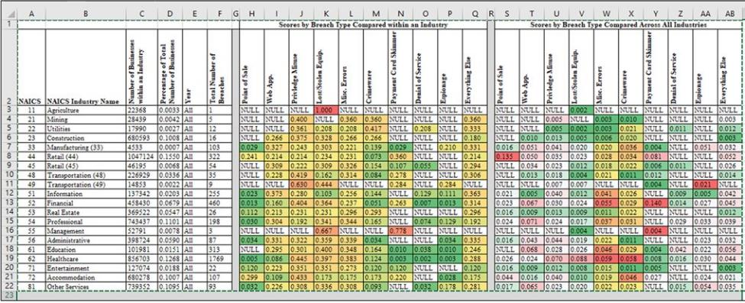
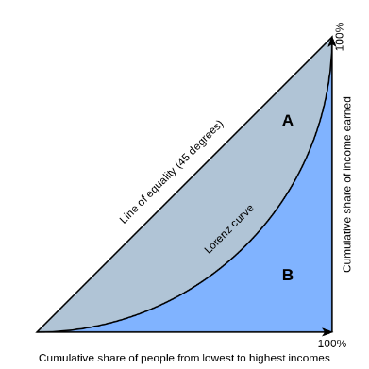
RISK Model 1:Application of Lorenz Curves for Risk Profiling
An illustration of scoring attack techniques within and across industries, by Dr Rasmussen.
Gini Index : (A)/(A+B)

Slide 21
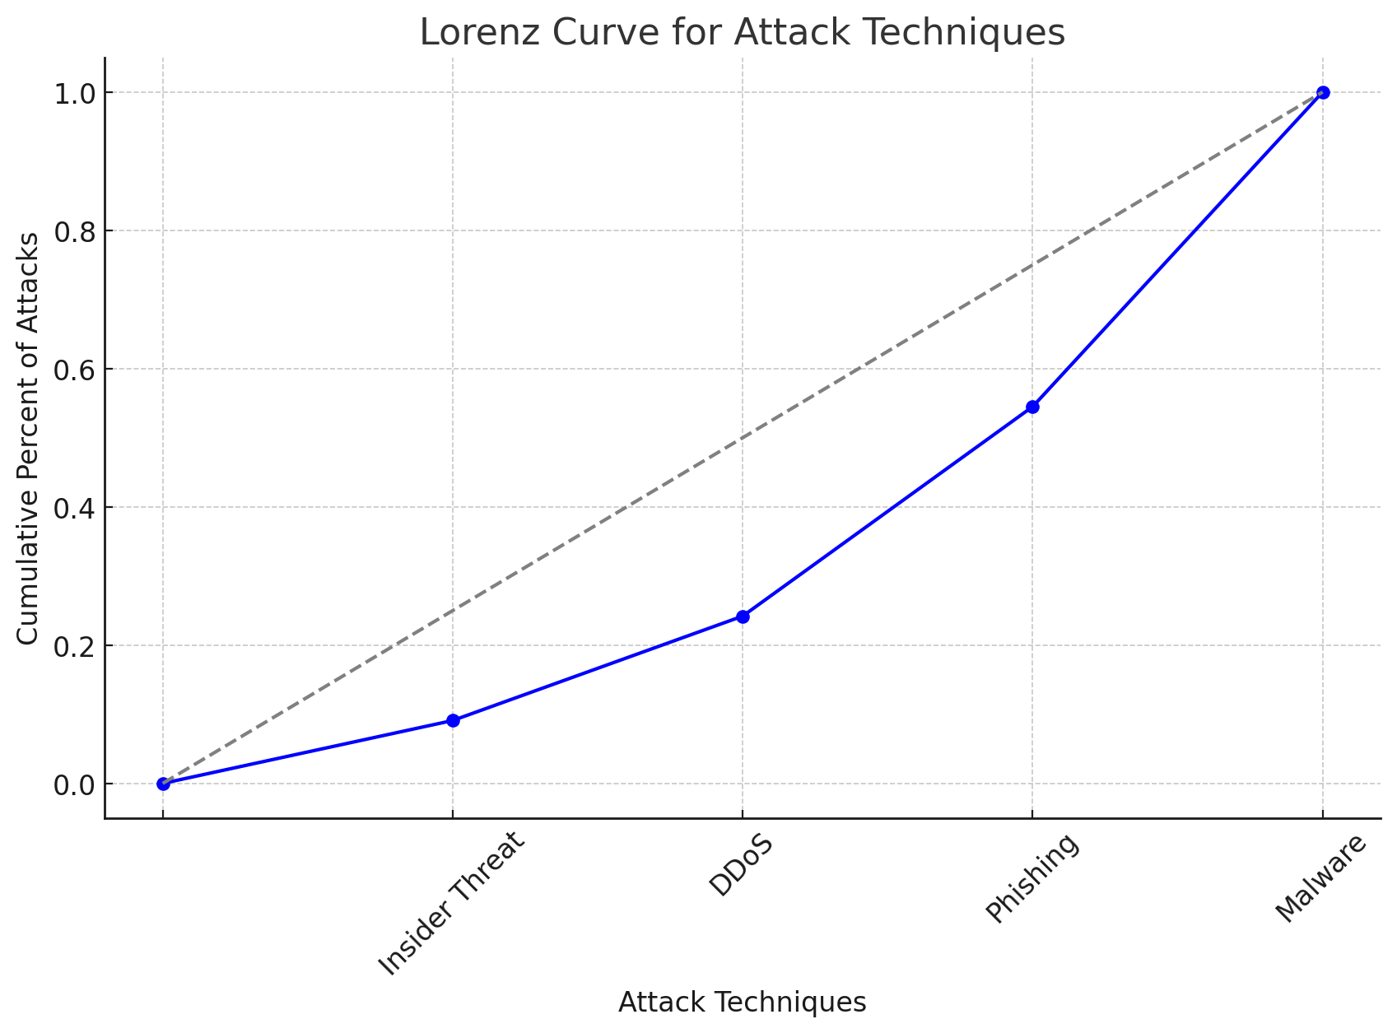
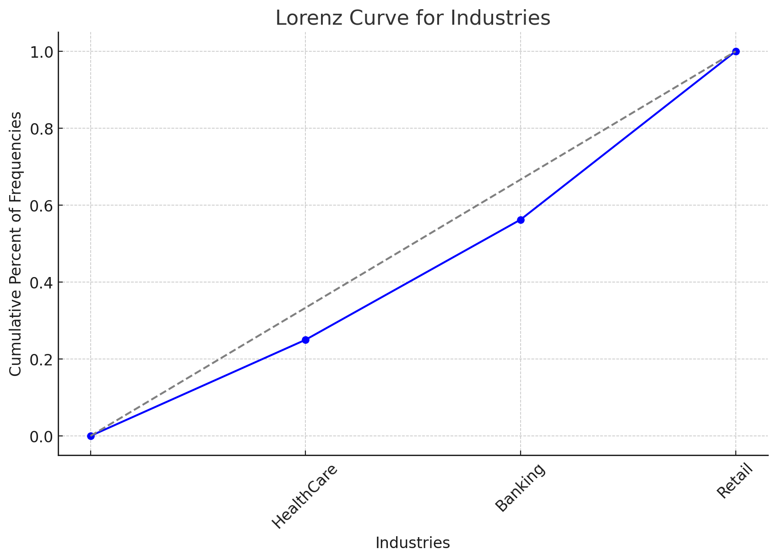
RISK Model 1:Application of Lorenz Curves for Risk Profiling
Industry | Phishing | Malware | DDoS | Insider Threat | Ransomware
Banking | 100 | 150 | 50 | 30 | 70
Healthcare | 80 | 120 | 40 | 60 | 100
Retail | 90 | 110 | 70 | 20 | 60
For Each industry, Equitability of incidents across all the attack techniques:
For Each Attack Type(technique), Equitability of incidents across all the Industry Sectors:
Attack Technique
Frequency
Cumulative Percent%
Banking Sector
DDoS
Attack Technique | Frequency | Cumulative %
Insider Threat | 30 | 9.1%
DDoS | 50 | 24.2%
Phishing | 100 | 54.5%
Malware | 150 | 100%
Industry | Frequency | Cumulative %
HealthCare | 40 | 25%
Banking | 50 | 56.25%
Retail | 70 | 100%
Gini Index : 0.311
Gini Index : 0.125
Finally, develop a scoring methodology to score each attack techniques based on their contribution to Gini.
Finally, develop a scoring methodology to score each Industry Sector based on their contribution to Gini.

Slide 22
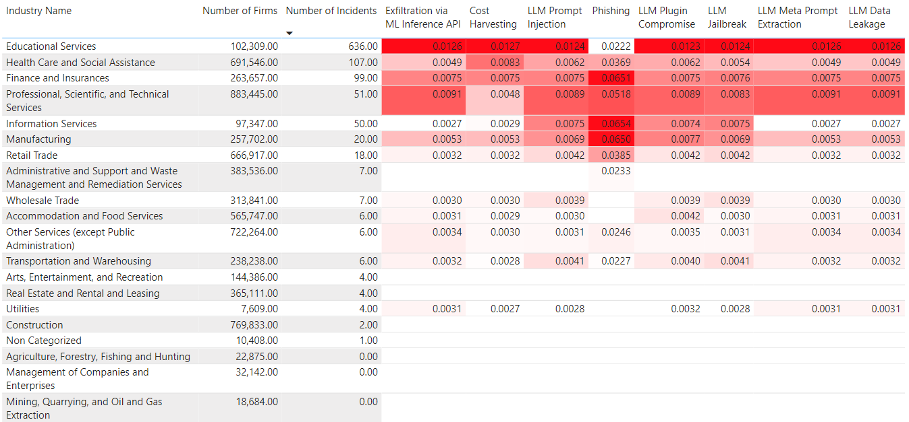
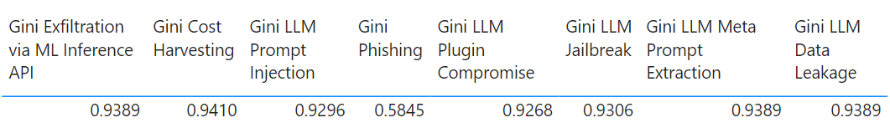
RISK Model 1: Lorenz curve risk score
High Level – Risk Score
Gini Index = 1 – Sum(Lorenz Curve Score)=

Slide 23




RISK Model 2: RISK metrics and formula
Features to be considered (from VERIS data):
ACTIONS
ASSETS
ATTRIBUTES
IMPACT ASSESSMENT
Various types of attacks
Data/Information resource affected
Result of the attack
Overall impact of the attack
ACROSS ALL INDUSTRIES IN THE US FROM 2020-present
In risk cyber security: Cyber risk = Threat x Vulnerability x Information Value [1]
Alternative; Risk = Threat x Vulnerability x Consequence [2]
FORMULA:
P(actor) X P(Sum of all actions) X P(Sum of all affected assets) X P(Sum of attributes) X P(Sum of Impact scores)

Slide 24
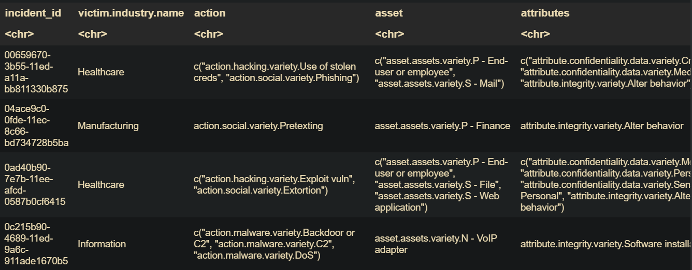
RISK Model 2: LOGIC and reasoning
Assumption: Considering the WORST-CASE SCENARIO; Multiple actions, multiple assets, and multiple attributes.
Mutually inclusive scenario.
Incident scenario from VERIS database.

Slide 25

RISK Model 2: Risk score model
Assigning weight to categorical variables, impact ratings
Formula:
P(actor) X P(Sum of all actions) X P(Sum of all affected assets) X P(Sum of attributes) X
P(Sum of Impact scores)

Slide 26
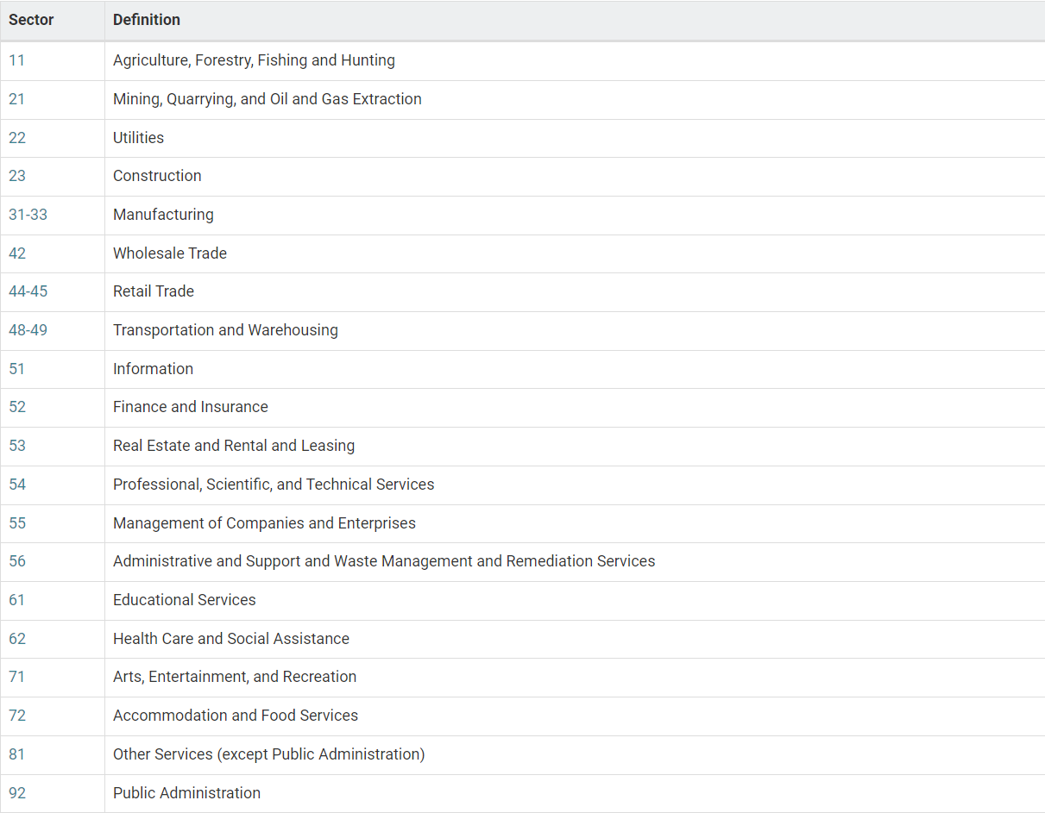
List of Industry Sectors , Susceptible to LLM risks
North American Industry Classification System (NAICS) code
First two-digit NAICS codes for Major Industry Sectors
Manufacturing & Supply Chain Management

Slide 27
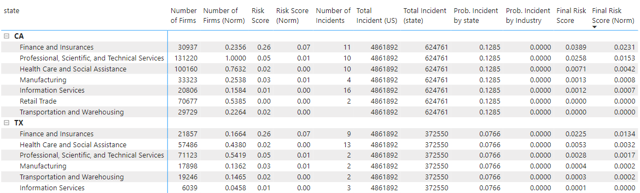
RISK Model 2: RISK FRAMEWORK - Final Risk score
Final Risk Score =
Composite Risk Score (norm) x Prob. Incident by state x Prob. Incident by Industry x Number of Firms (norm)
x 1,000,000
=>
=>
Total incident in state Incident in specific industry in state
Total incident in US Total incident in state
NAICS Code
CENSUS DATA
VERIS DATA
Final Risk Score

Slide 28
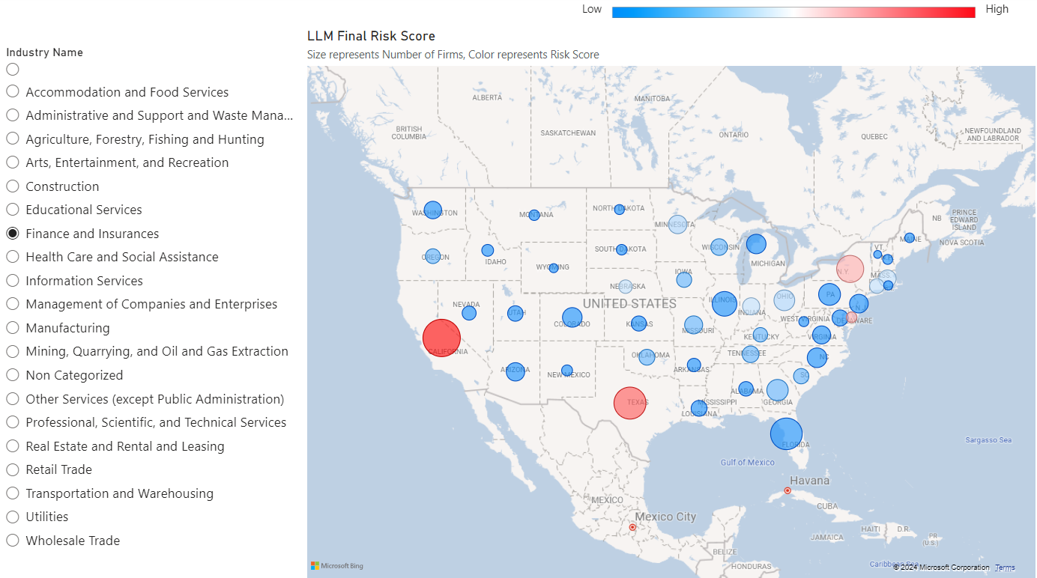
RISK Model 1: Lorenz curve risk score - Geographical visualization
Financial Sector: LLM Prompt Injection

Slide 29
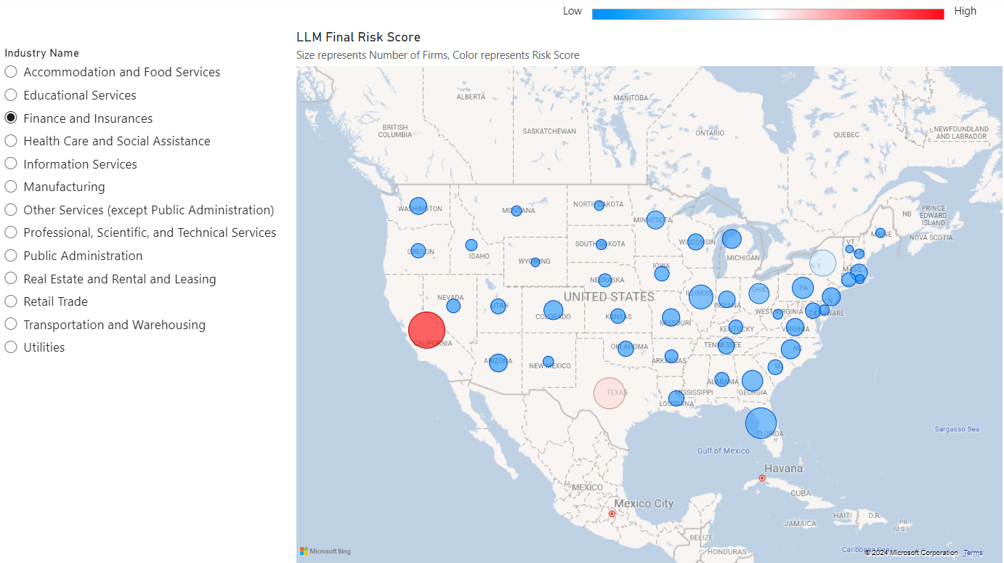
RISK Model 2: RISK FRAMEWORK - Geographical visualization
Financial Sector: Overall LLM attacks

Slide 30
Summary
Key Takeaways and Insights
Developing Risk Framework
Vulnerable Industries
Geographical Visualization
External attacks are most probable across all industries.
Web Application and Databases are common targets.
Integrity hampered by software installation. Personal data affected the most.
Wide range of impact, damaging is the highest.
Education and Finance are the most vulnerable industries to LLM attacks.
California, Texas, and New York have highest number of business, hence, susceptible to LLM attacks.
Visualizing LLM risks across US states using CENSUS data.
Visualizing specific risk corresponding to an industry across US states.
Notes:
[ Risk Framework] Actor type :External , Asset type : Web application and Databases, Attributes type: integrity hampered by software installation / personal data, Impact type :Damaging.
[Vulnerable Industries]: Education and Finance . CA,TX, and NY for overall LLM attacks.

Slide 32
THANK YOU

